Slide 1
Intelligent Hand-eye Expert
RVC Series
3D Area Scanner
RVC-G series
www.rvbust.com

Slide 2
Professional 3D area scanner built for craftsmanship
Intelligent Hand-eye Expert
RVC-G31800
Medium field of view
3D Area Scanner
RVC-G31800 medium field of view 3D area scanner, with high precision, high protection, excellent resistance to ambient light performance, can be complex structure, tightly stacked, disorderly stacking of various types of objects to take pictures and output a complete, accurate, high-quality 3D point cloud data, to meet the needs of various types of material sorting, loading and unloading and other visual guidance, is widely used in automotive manufacturing, logistics, electronics, heavy machinery, food, home appliances and other fields.
High-strength carbon fiber fuselage for all-around protection
Waterproof level greatly improved
Dust proof level greatly improved
Passed professional vibration test
Gigabit Ethernet port data transfer
Compact design
Stable performance
Lighter weight
High strength carbon fiber body design
IP65 rated protection
Laser Projection
Sharper Imaging
Fan-free cooling design
Equipped with High resolution lens
Good stability and higher protection
Improve point cloud quality
www.rvbust.com
400 - 0419 - 900
sales@rvbust.com

Slide 3
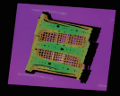
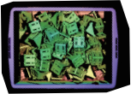
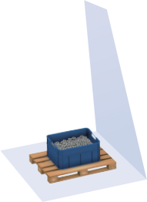
Professional 3D area scanner built for craftsmanship
Intelligent Hand-eye Expert
Core Advantages
Higher precision
With laser projection technology, the point cloud quality is higher and the accuracy is up to 0.05mm.
Anti ambient light interference
Professional optical system design, self-developed point cloud reconstruction algorithm, greatly improving the ability to resist ambient light interference.
Point cloud display
Body B-pillar workpiece point cloud
Aluminum corner piece point cloud
Product reference data
model | RVC-G31800
Minimum shooting time (sec / frame) | 1.2
Resolution (MP) | 3.2
Operating distance range (mm) | 750~1500
Near Field of View (FOV) (mm) | 800*650@750
Far Field of View (FOV) (mm) | 1800*1220@1500
XY direction resolution (mm) | 0.5~1.3
Z-axis single-point repetition accuracy (mm) | 0.05~0.2
Repeat accuracy of the Z-axis region (mm) | 0.016~0.037
illuminant source | Laser
Communication interface | Gigabit Ethernet
Camera weight (kg) | 2.2
Camera size (mm) | 530*130*67
Operating voltage / current | DC 24V/3.75A
Levels of protection | IP65
Operating temperature (°C) | 0~45
Operating Humidity (RH) | 20~80% (no condensation)
Standard fitting | Power supply adapter, power supply cord, data cable
Whether the third-party development is supported | yes
Supported development language | C/C++/C#/Python
Supported development platform | Linux/Windows
Adapt to the third-party software library | Halcon/OpenCV/Open3D/PCL/VisionPro
750mm
1500mm
650mm
800mm
1220mm
1800mm
www.rvbust.com
400 - 0419 - 900
sales@rvbust.com

Slide 4
Professional 3D area scanner built for craftsmanship
RVC-G33500
Large Field of View
3D Area Scanner
RVC-G33500 3D area scanner with large field of view, 3.5×2.4@3m large field of view, 1.8m large depth of field, sub-millimeter accuracy, IP65 protection, excellent ambient light resistance. It can quickly measure all kinds of objects such as closely stacked and disorderly placed cartons, sacks, steel workpieces, etc. and output comple-te, accurate and high-quality 3D point cloud data. RVC-G33500 is widely used in logistics, express delivery, heavy machinery and other typical depalletizing and handling scenarios.
Intelligent Hand-eye Expert
High-strength carbon fiber fuselage for all-around protection
Waterproof level greatly improved
Dust proof level greatly improved
Passed professional vibration test
Gigabit Ethernet port data transfer
Compact design
Stable performance
Lighter weight
High strength carbon fiber body design
IP65 rated protection
Laser Projection
Sharper Imaging
Fan-free cooling design
Equipped with High resolution lens
Good stability and higher protection
Improve point cloud quality
www.rvbust.com
400 - 0419 - 900
sales@rvbust.com

Slide 5
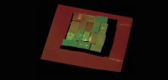
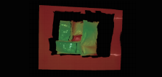
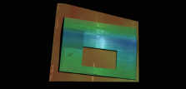
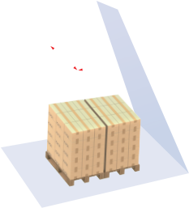
Professional 3D area scanner built for craftsmanship
Intelligent Hand-eye Expert
Core Advantages
large field of view
3.5×2.4@3m large field of view, 1.8 meters large depth of field, to meet the application of long-distance large field of view.
highly accurate
With laser projection technology, the point cloud quality is higher, and the accuracy is up to 0.06mm.
light weight
High-strength carbon fiber body design, the camera is only 2.5kg, more flexible installation environment.
Anti ambient light interference
Professional optical system design, self-developed point cloud reconstruction algorithm, greatly impro-ving the ability to resist ambient light interference.
Point cloud display
Various carton
point clouds
Softpack
point cloud
Large vehicle body parts
point cloud
Product reference data
model | RVC-G33500
Minimum shooting time (sec / frame) | 1.4
Resolution (MP) | 3.2
Operating distance range (mm) | 1200~3000
Near field of view (FOV) (mm) | 1200*1000@1200
Far field of view (FOV) (mm) | 3500*2400@3000
XY directional resolution (mm) | 0.8~1.82
Z-axis single-point repetition accuracy (mm) | 0.06~0.88
Repeat accuracy of the Z-axis region (mm) | 0.01~0.25
illuminant source | Laser
Communication interface | Gigabit Ethernet
Camera weight (kg) | 2.5
Camera size (mm) | 940*130*67
Operating voltage / current | DC 24V/3.75A
Levels of protection | IP65
Operating temperature (°C) | 0~45
Operating Humidity (% RH) | 20~80 (no condensation)
Standard fitting | Power supply adapter, power supply cord, data cable
Whether the third-party development is supported | yes
Supported development language | C/C++/C#/Python
Supported development platform | Linux/Windows
Adapt to the third-party software library | Halcon/OpenCV/Open3D/PCL/VisionPro
1200mm
1000mm
1200mm
3000mm
2400mm
3500mm
www.rvbust.com
400 - 0419 - 900
sales@rvbust.com

